Slide 1
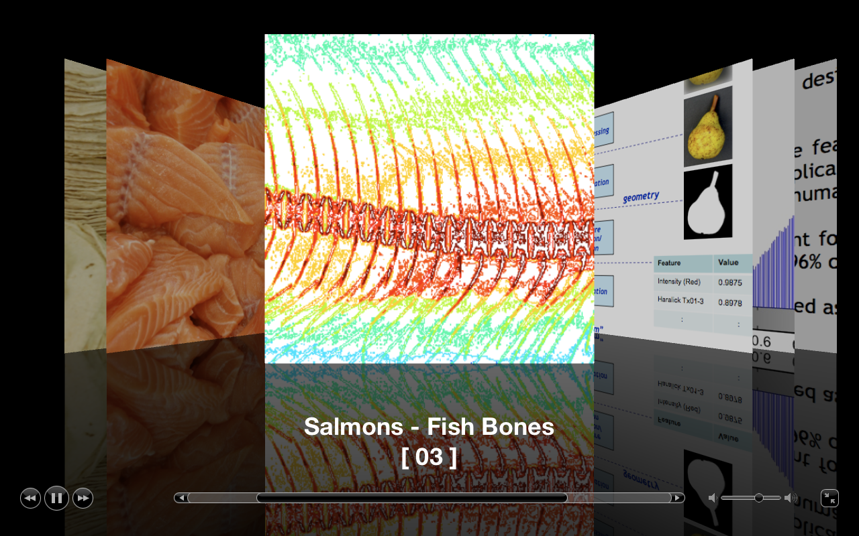
Inspection with X-rays
[ 03 ]

Slide 2
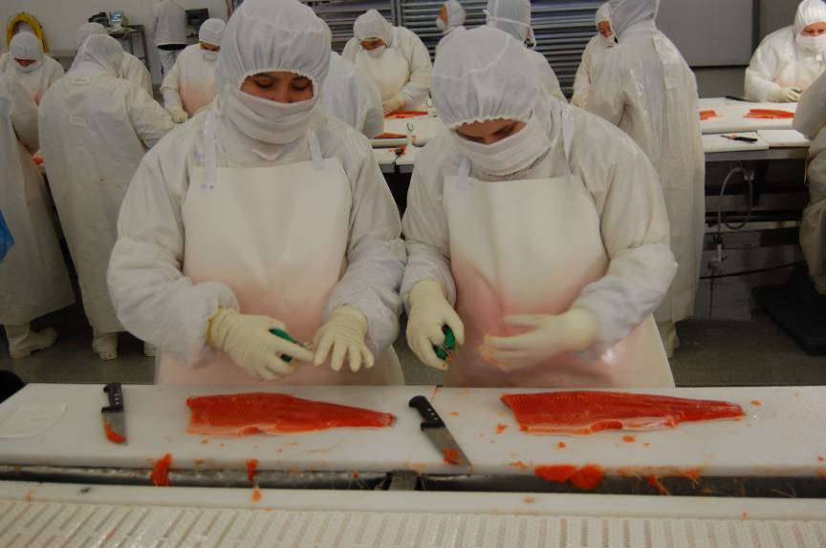

Slide 3
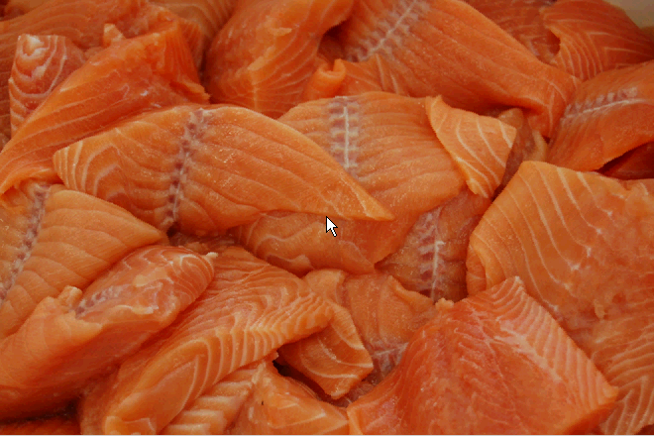

Slide 4
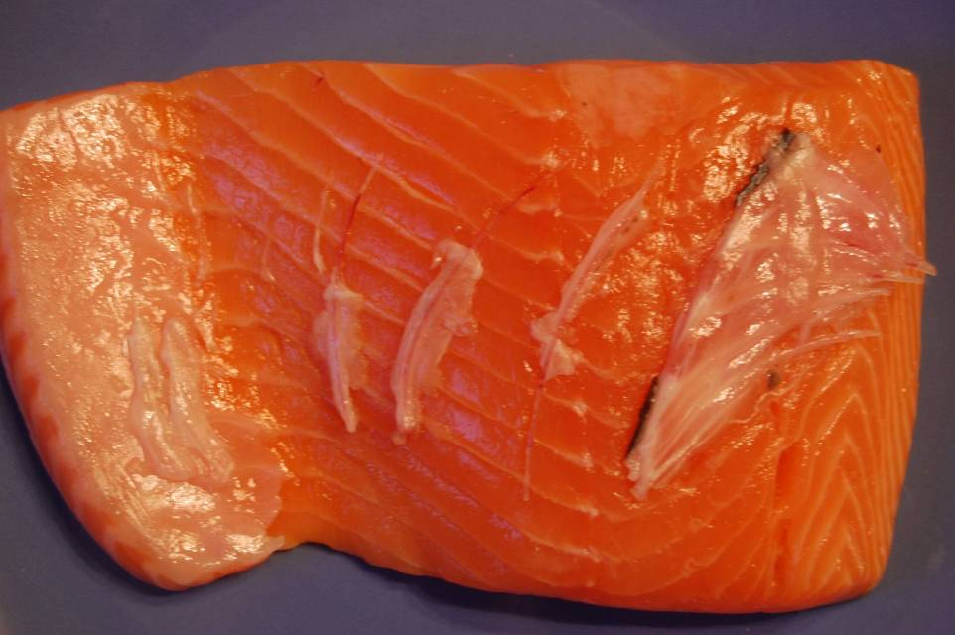

Slide 5
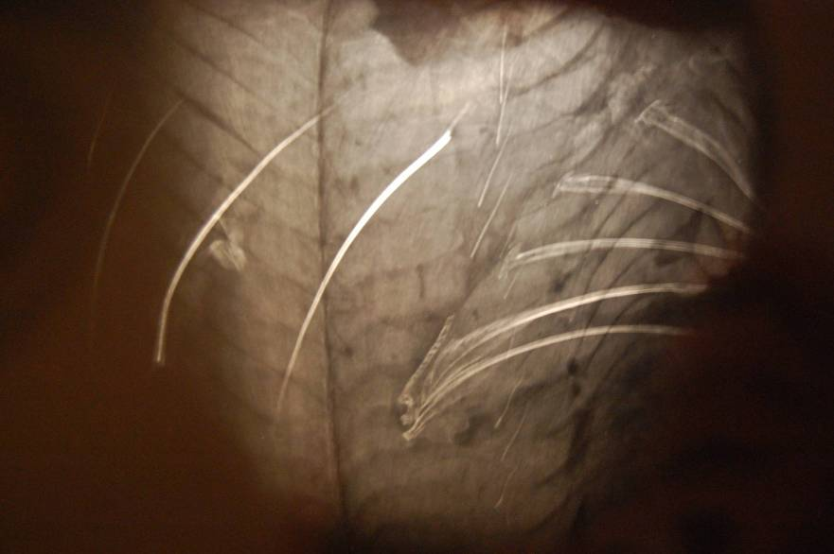

Slide 6
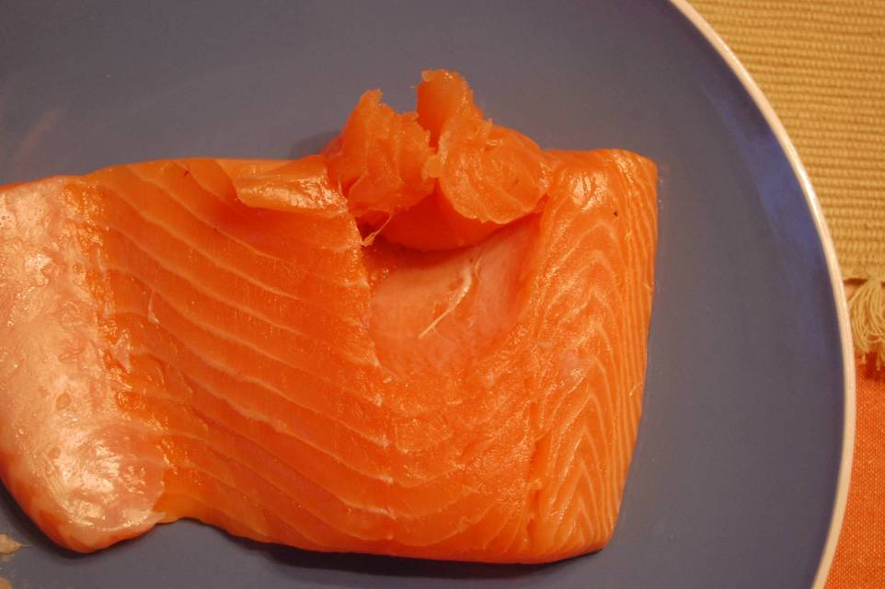

Slide 7
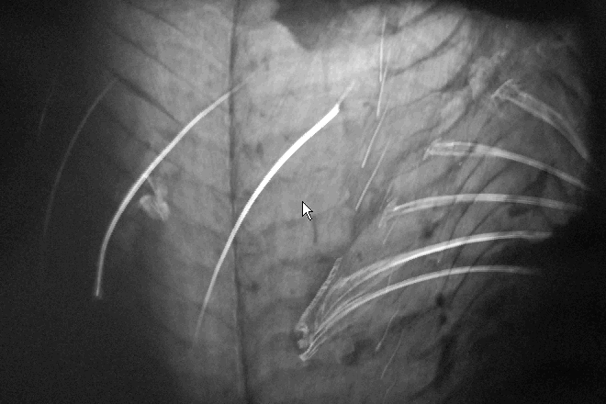

Slide 8
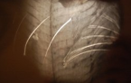
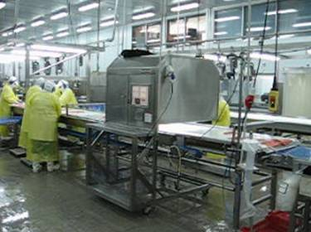
Detector
Salmon Filet
Cabine
X ray
Source

Slide 9
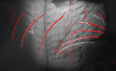
Preprocessing
Detector
Salmon Filet
Segmentation
Cabine
Feature Extraction
X ray
Source
Área
420
Perímetro
310
Tono gris
180
:
:
Classification
Fish-Bones
Computer Vision Methodology

Slide 10
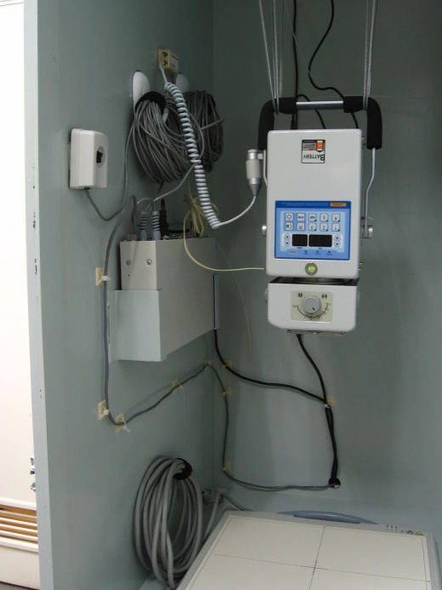
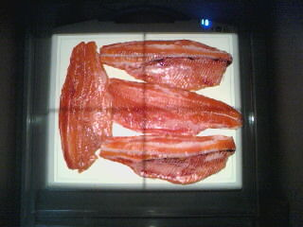

Slide 11
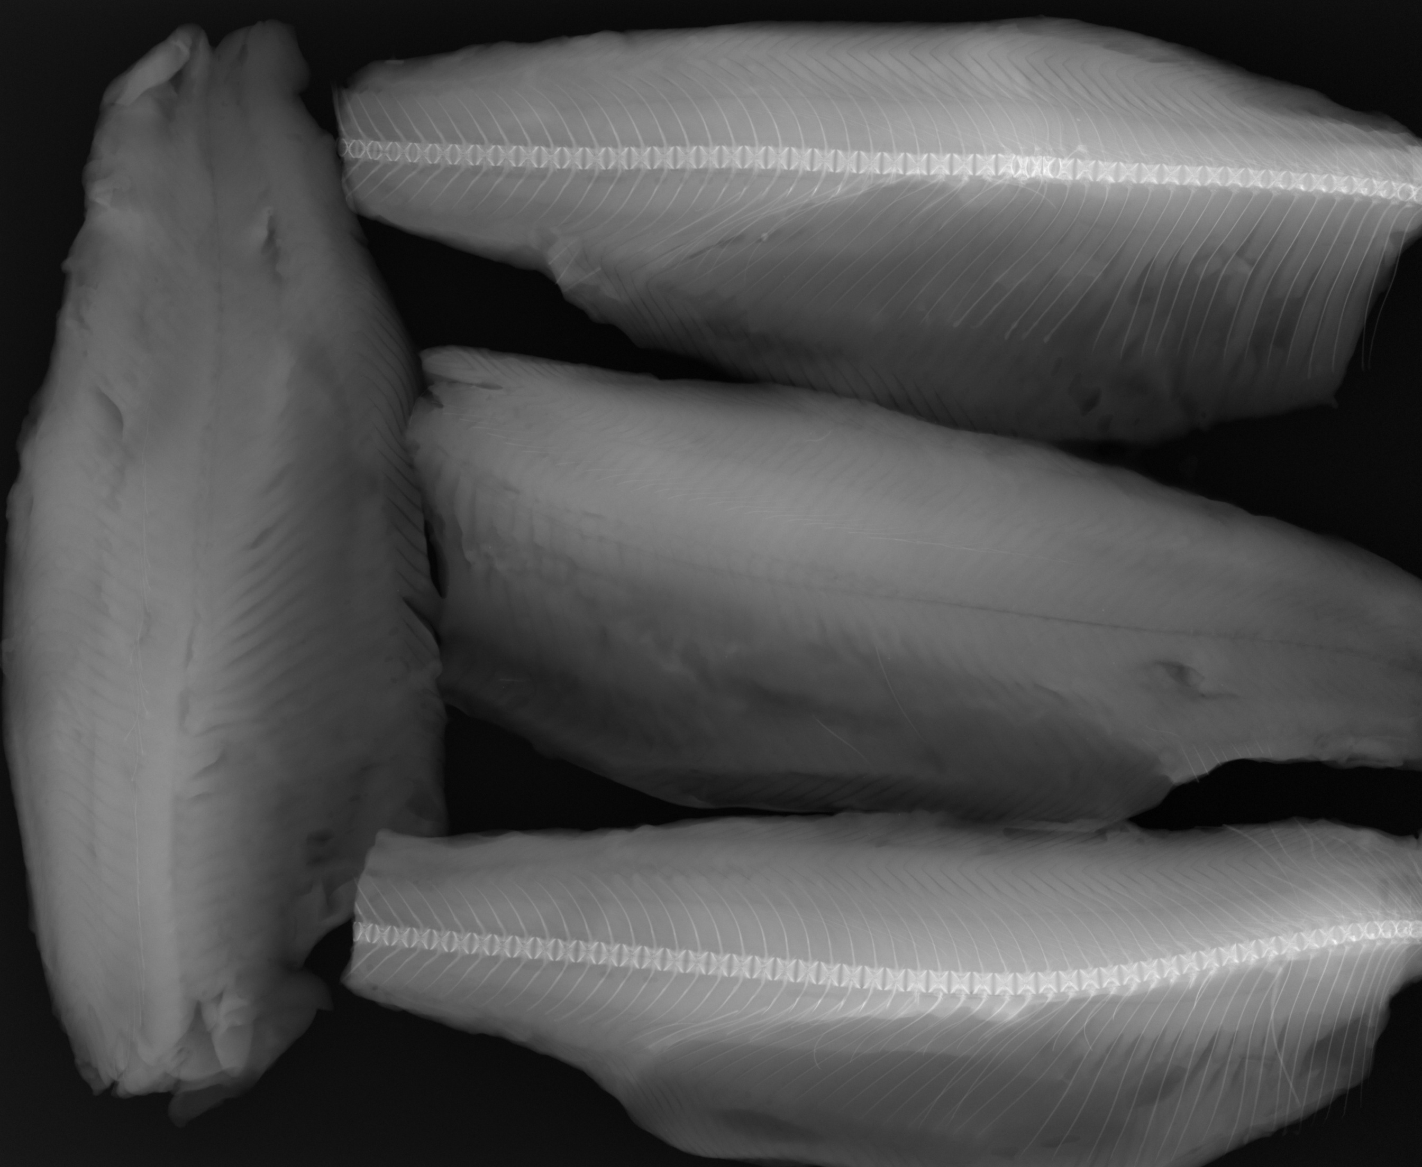

Slide 12
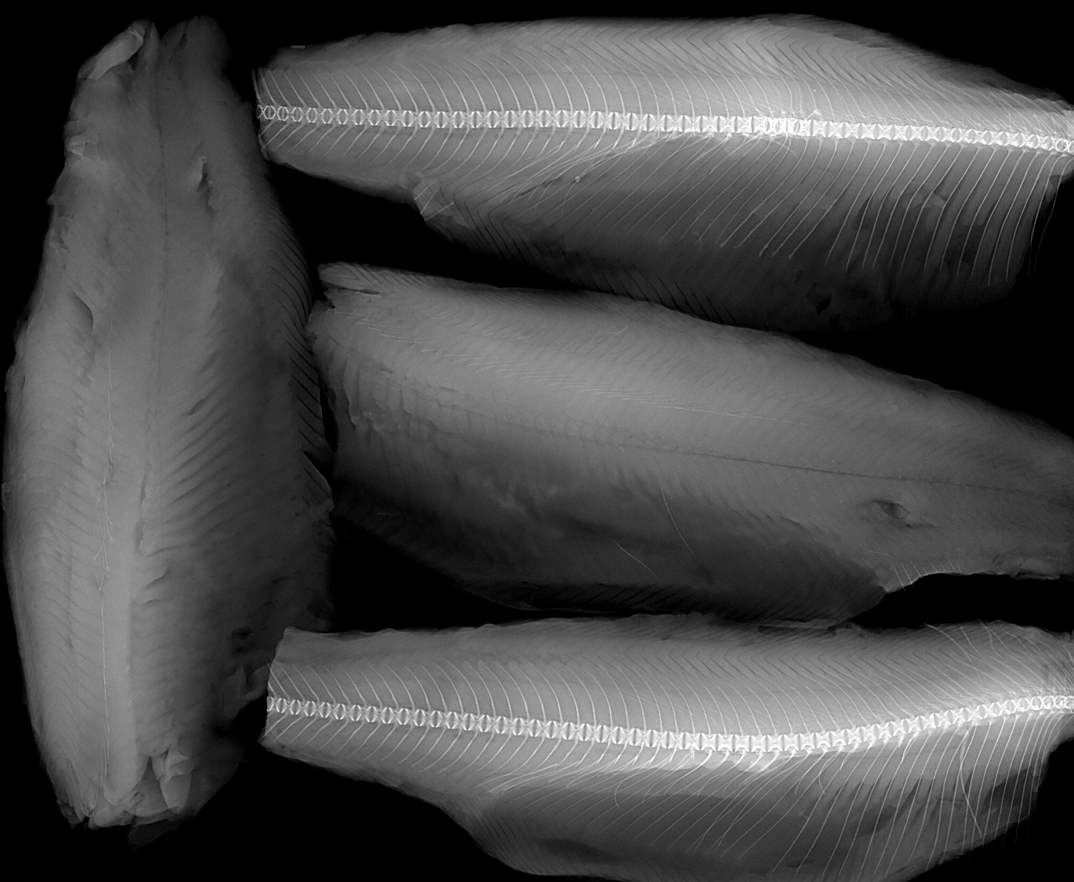

Slide 13
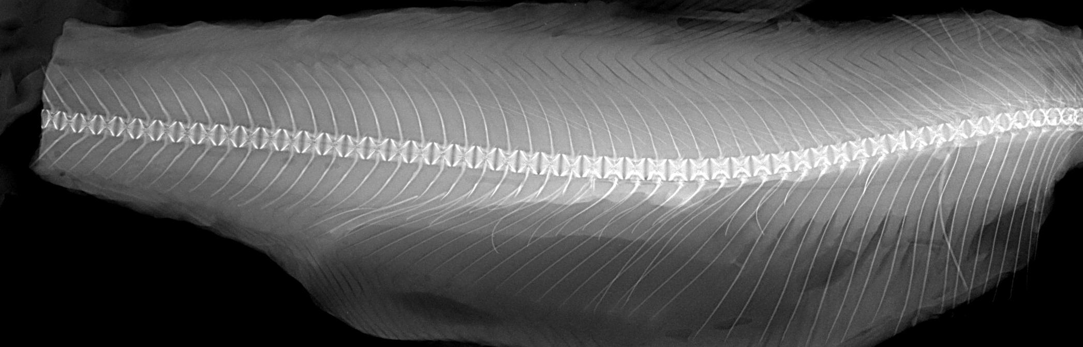

Slide 14
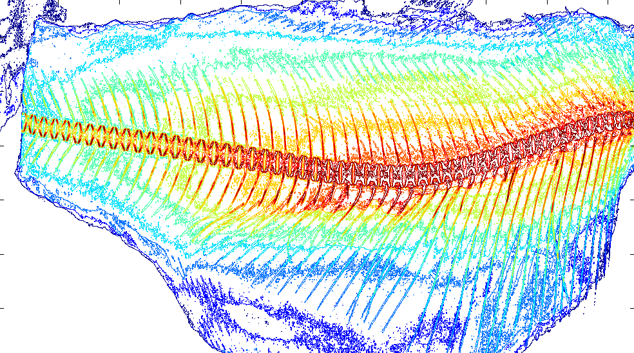

Slide 15
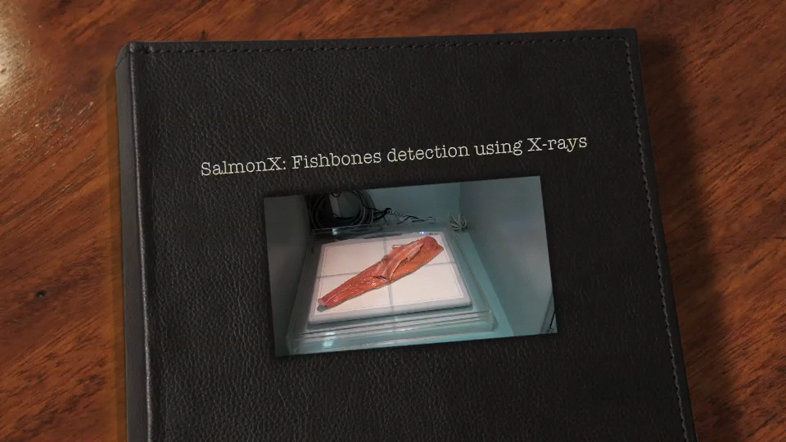

Slide 16
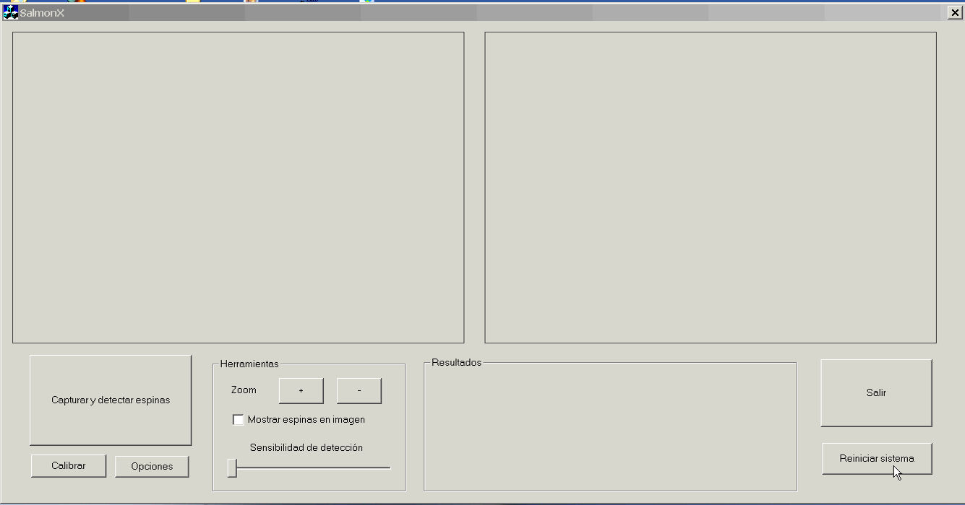

Slide 17
One more example with X-rays…

Slide 18
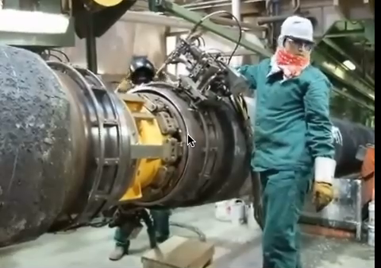
X-ray testing: Welds

Slide 19
X-ray testing: Welds – Inspection
X-ray
source
Steel
pipe
X-ray
detector

Slide 20
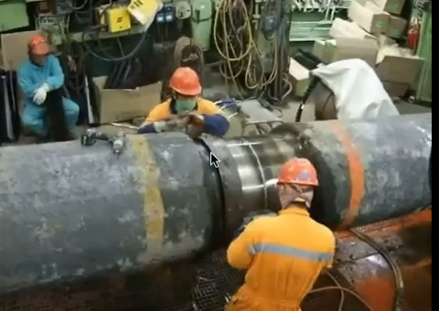
X-ray testing: Welds – Inspection

Slide 21
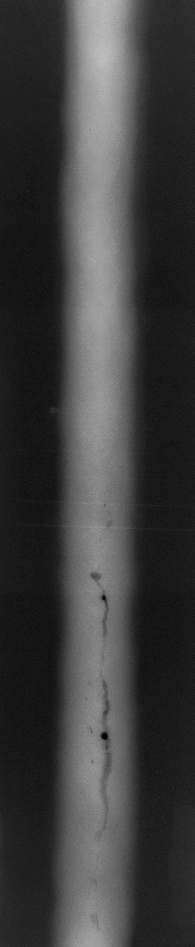
X-ray testing: Welds - Inspection

Slide 22
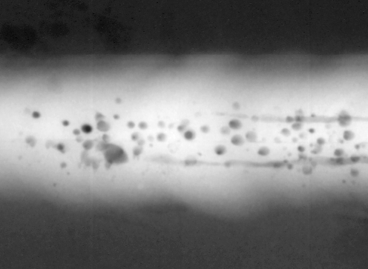
X-ray testing: Welds – Inspection

Slide 23
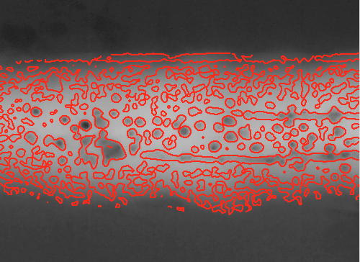
X-ray testing: Welds – Inspection

Slide 24
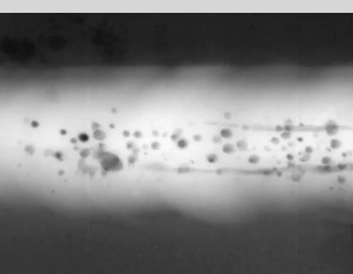
X-ray testing: Welds – Inspection
Positive & Negative samples
Feature
Extraction
Feature
Selection
Classifier

Slide 25
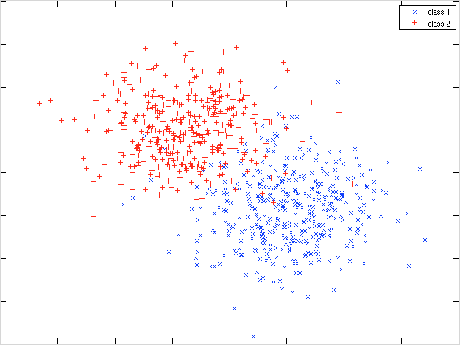
feature 2
Class 2
Class 1
feature 1

Slide 26
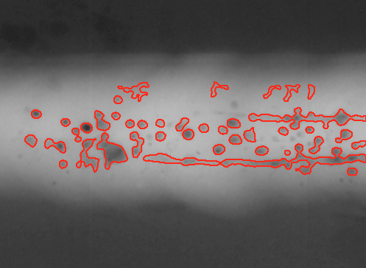
X-ray testing: Welds – Inspection

Slide 27
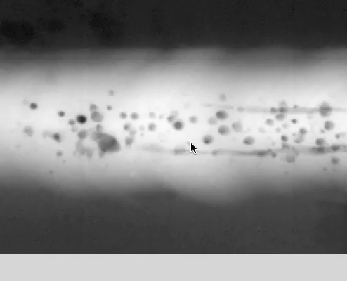
X-ray testing: Welds – Inspection
Positive & Negative samples
Feature
Extraction
Feature
Selection
Classifier

Slide 28
X-ray testing: Welds – Inspection

Slide 29
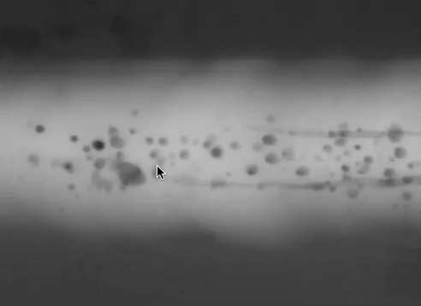
X-ray testing: Welds – Inspection

Slide 30
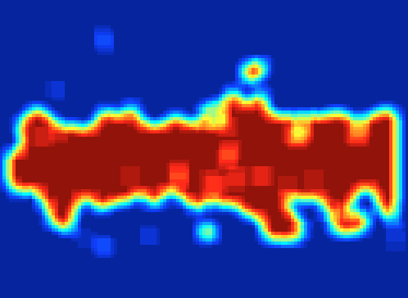
X-ray testing: Welds – Inspection

Slide 31
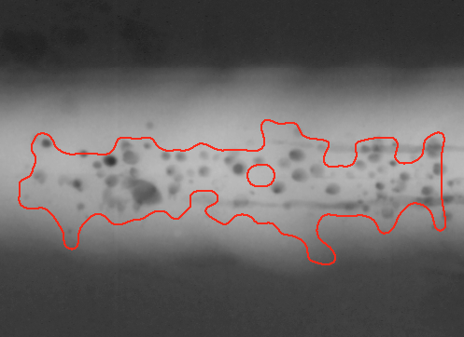
X-ray testing: Welds – Inspection

Slide 32
Inspection with X-rays
[ 03 ]

Slide 33
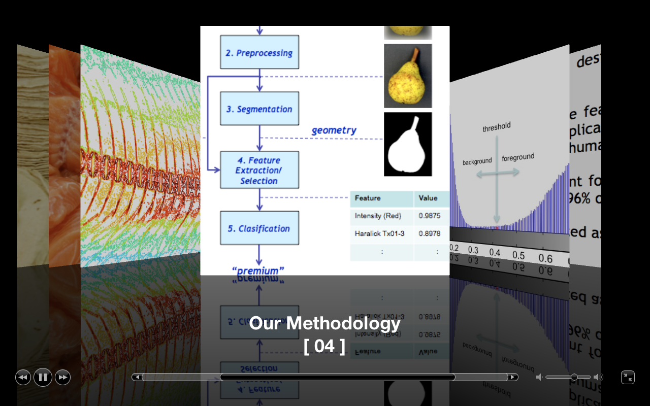

Slide 34
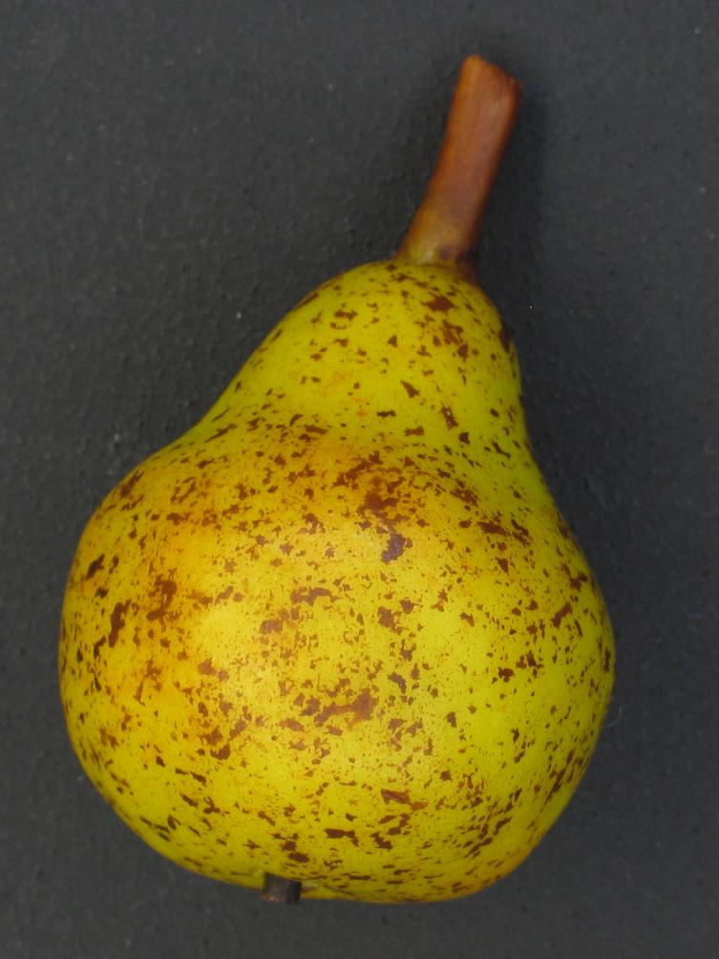
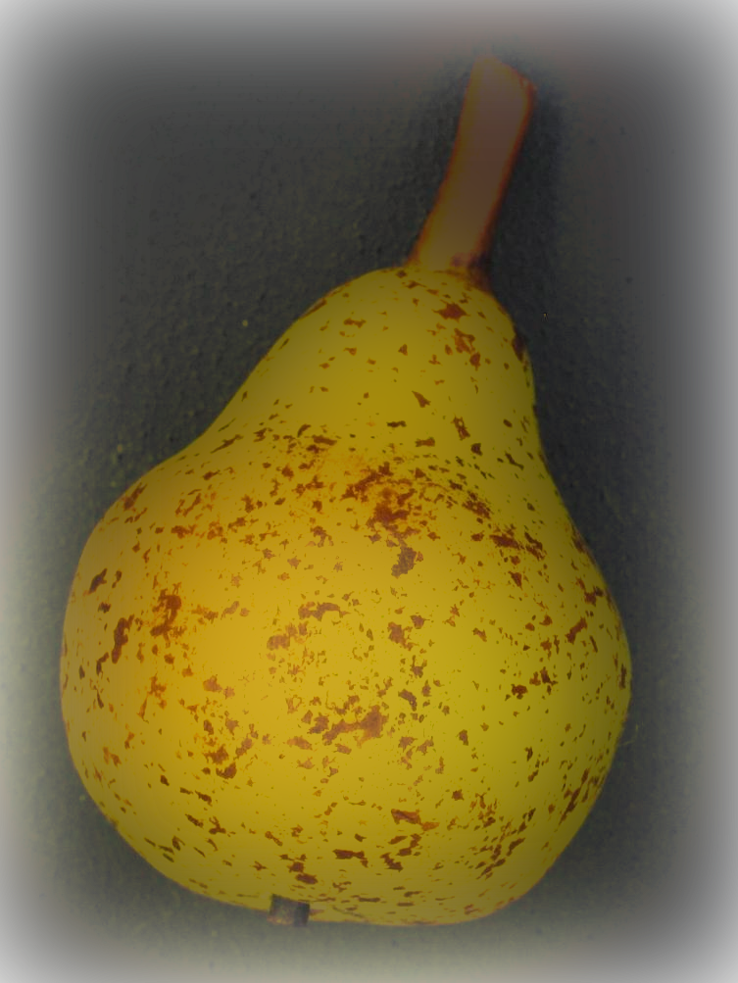
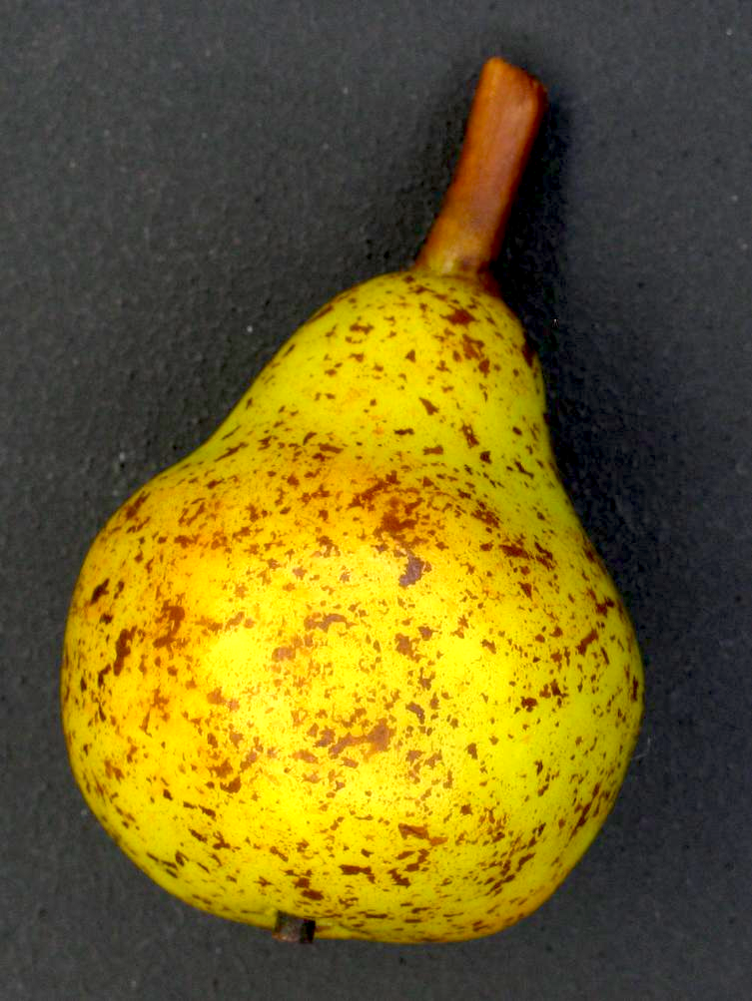
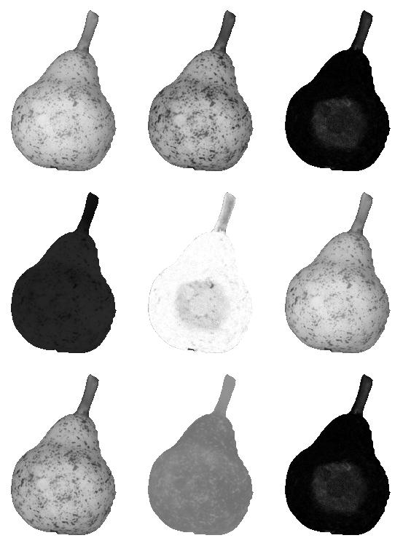
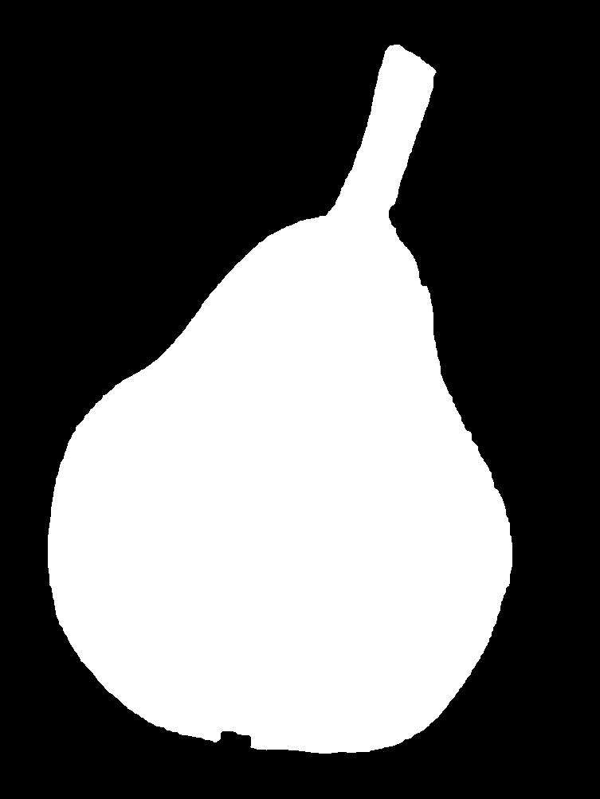
1. Image Acqusition
2. Preprocessing
3. Segmentation
R G B
color
geometry
4. Feature
Extraction/
Selection
H S V
Feature | Value
Intensity (Red) | 0.9875
Haralick Tx01-3 | 0.8978
: | :
5. Clasification
L* a* b*
“premium”

Slide 35
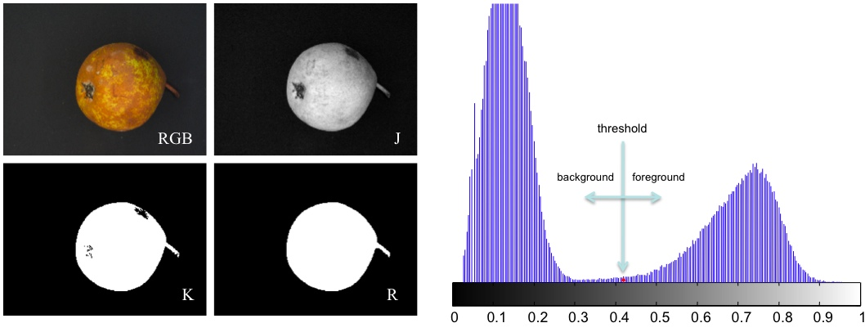

Slide 36
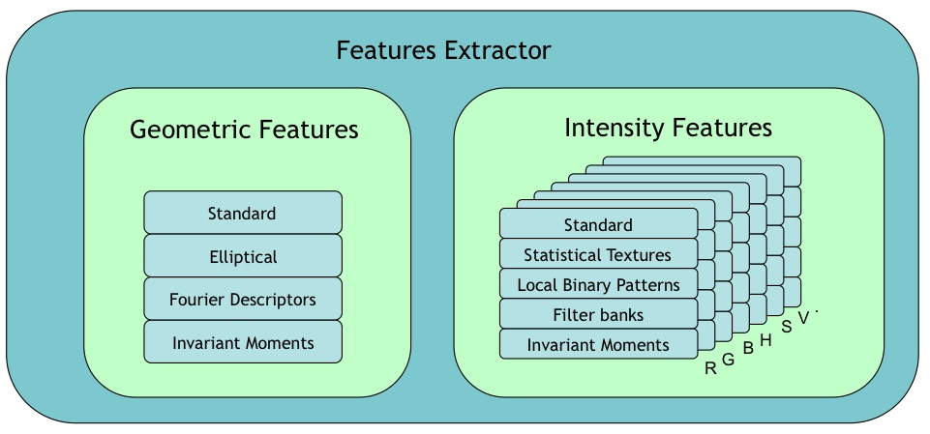

Slide 37
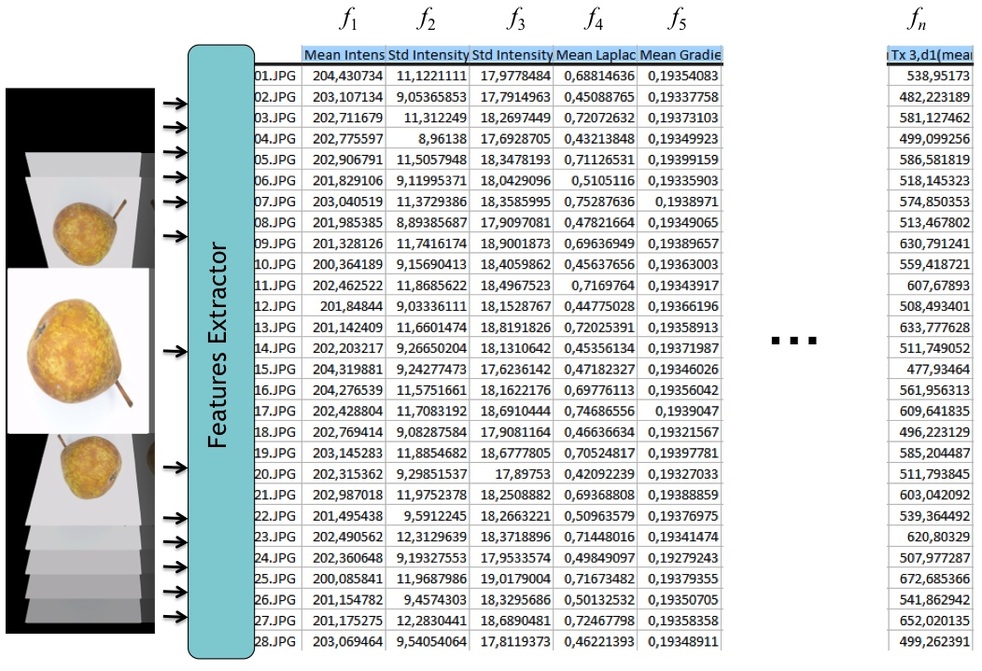

Slide 38
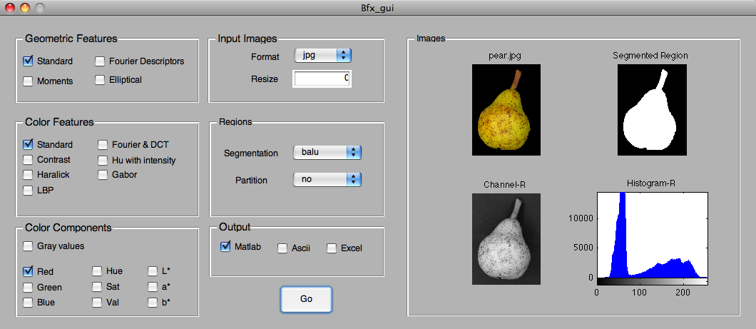

Slide 39
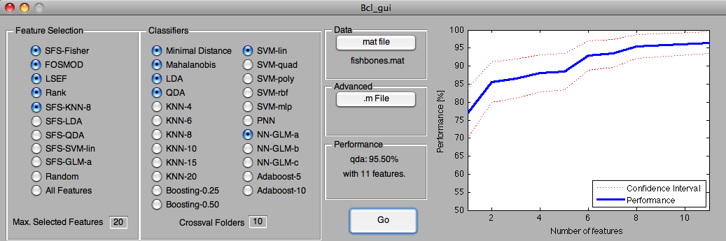

Slide 41
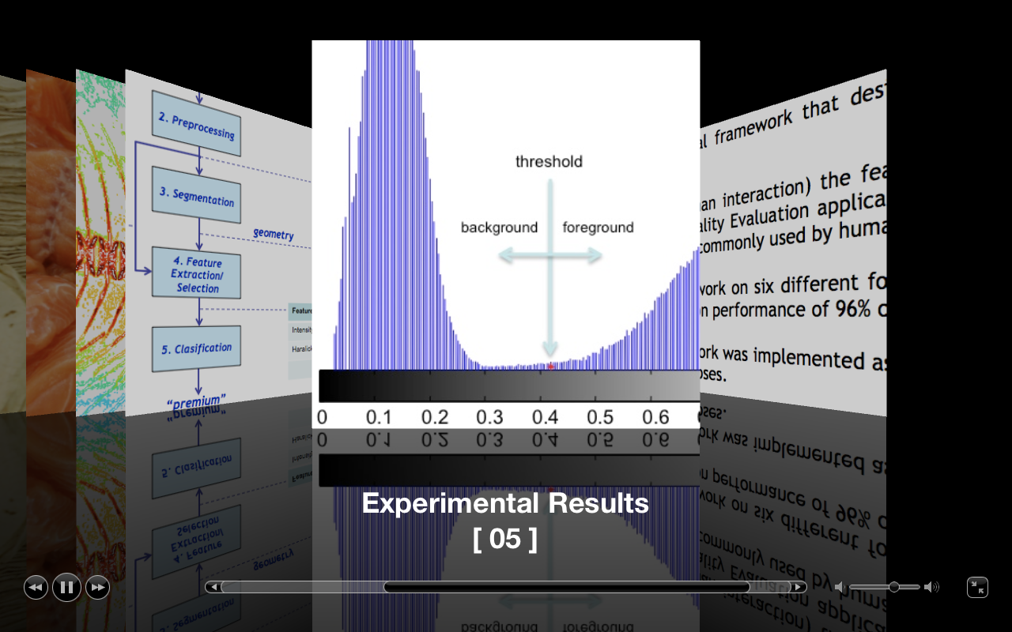

Slide 42
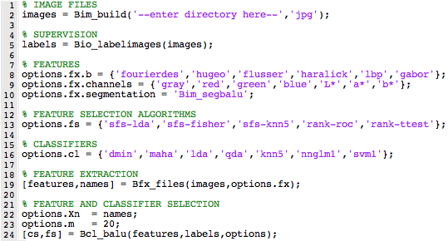

Slide 43
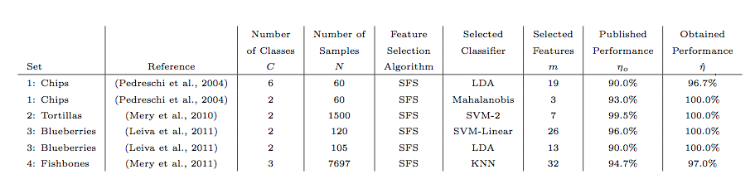
Performance in Experimental Results

Slide 45
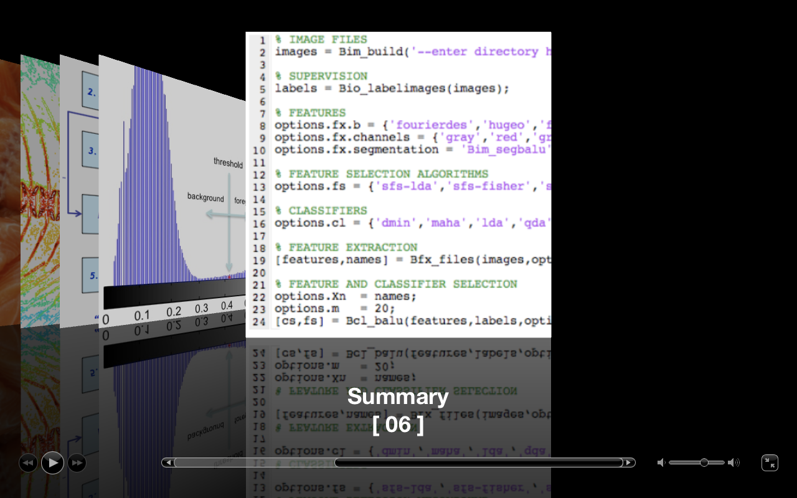

Slide 46
Highlights
We propose a general framework that designs a computer vision system automatically.
It finds (without human interaction) the features and the classifiers for a given Visual Quality Evaluation application avoiding the classical trial and error framework commonly used by human designers.
We tested our framework on six different food quality evaluation problems yielding a classification performance of 96% or more in every case.
The proposed framework was implemented as a Matlab Toolbox available for non-commercial purposes.

Slide 48
Automated Design of a
Computer Vision System for
Quality Control
Domingo Mery
Department of Compute Science
Universidad Católica de Chile (PUC)
http://dmery.ing.puc.cl
Guanajuato, October 2013

Slide 49
Automated Design of a
Computer Vision System for
Quality Control
Domingo Mery
Department of Compute Science
Universidad Católica de Chile (PUC)
http://dmery.ing.puc.cl
Guanajuato, October 2013

